Slide 1
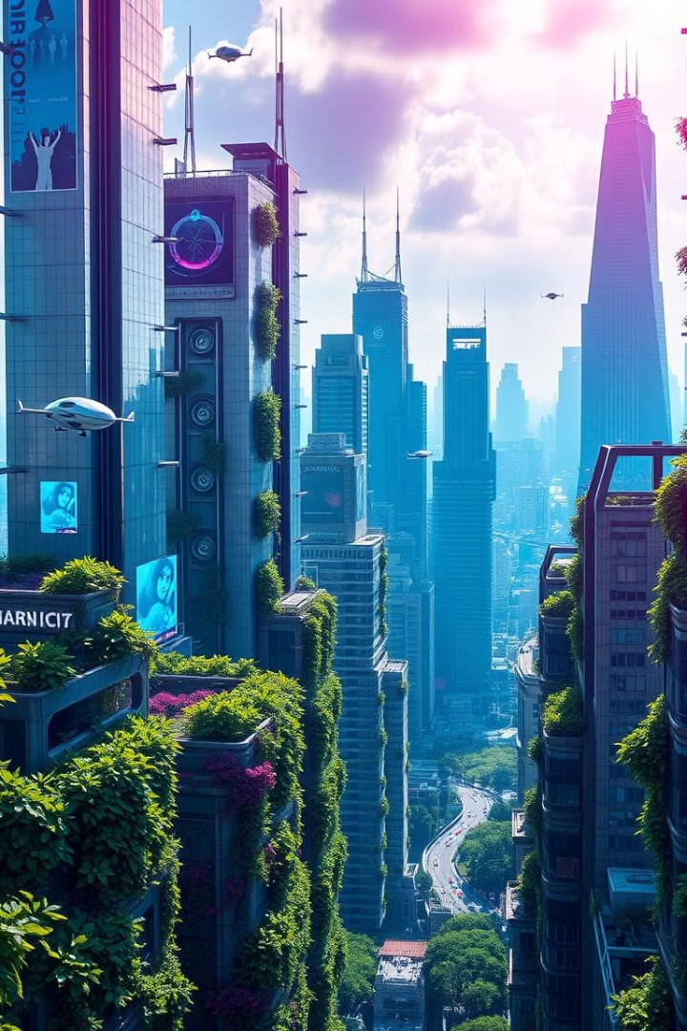

Tech Urban Canopy: Greening the City, One Plant at a Time
Welcome to Tech Urban Canopy, where we're revolutionizing urban sustainability through innovative technology and a commitment to green solutions. Join us as we explore our vision for a greener, more resilient future.
by shiva sai

Slide 2
The Urban Sustainability Challenge
Heat Island Effect
Waste Management
Carbon Footprint
Extreme heat in urban areas impacts residents' health and well-being. This is exacerbated by buildings and pavements absorbing and releasing heat, contributing to higher temperatures than surrounding areas.
Growing cities are generating more waste, leading to challenges with collection, disposal, and environmental impacts. This includes air and water pollution from landfills and overflowing trash bins.
Urbanization is a significant contributor to climate change, with high emissions from transportation, energy consumption, and industrial activity. Sustainable practices are crucial to mitigate this.

Slide 3
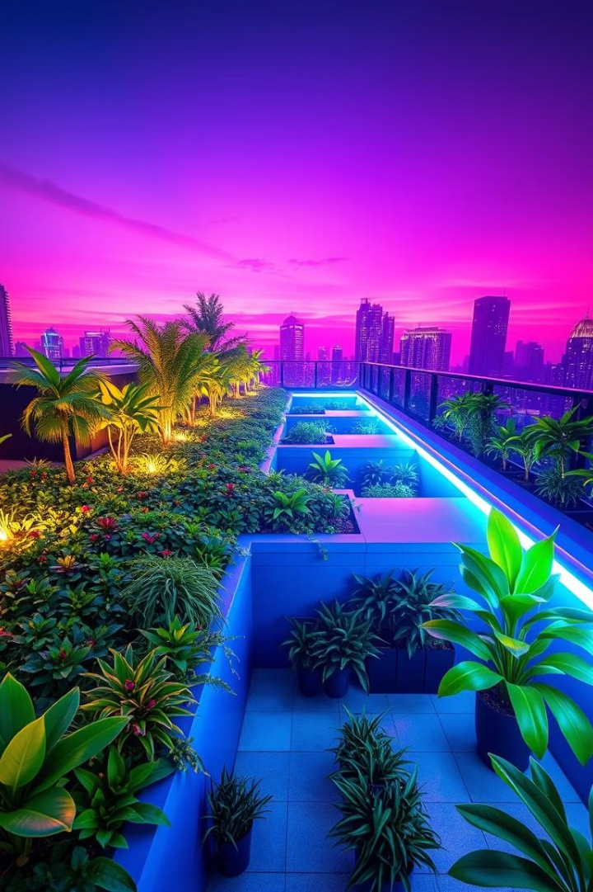
Tech Urban Canopy's Solutions
Plant Provision & Maintenance
Data Tracking & Analytics
Our technology tracks environmental metrics such as carbon footprints, air quality, and waste diversion to provide insights and accountability. This data helps us optimize our solutions and measure our impact.
We provide a wide range of plants and green installations, including vertical gardens, rooftop gardens, and urban forestry solutions. We offer maintenance services to ensure healthy growth and optimal environmental impact.
Smart Waste Management
We implement intelligent waste management systems that optimize collection routes, reduce waste volume, and promote recycling. This helps reduce the environmental impact of waste disposal.

Slide 4
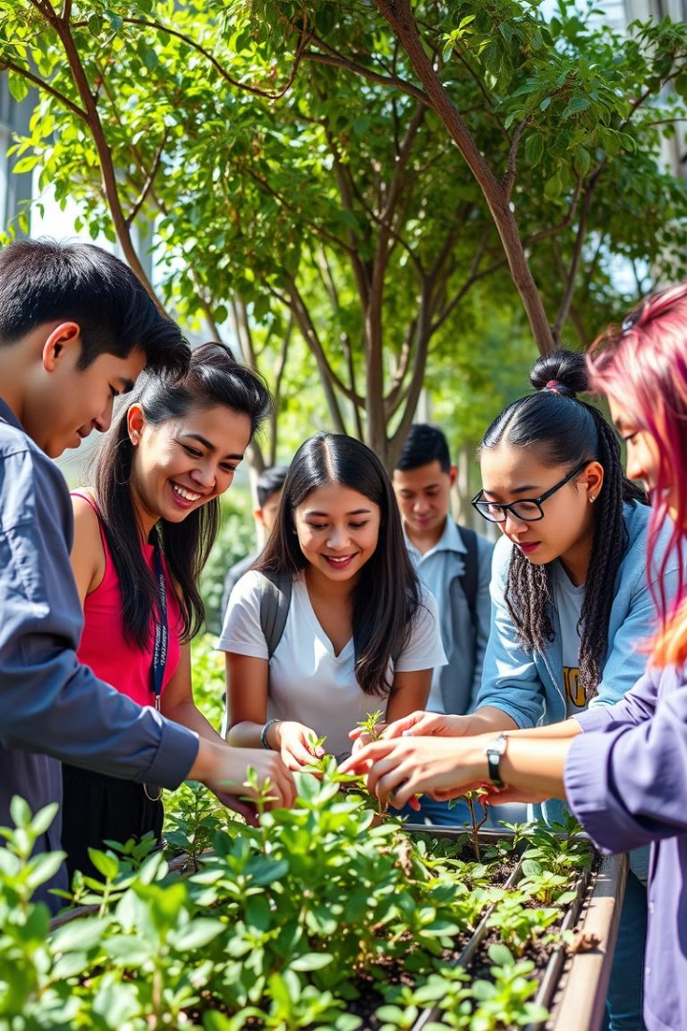



Our Unique Approach
Academic Collaboration
We partner with universities and enthusiastic environmentalists to ensure our plants receive expert care. This fosters environmental education and community involvement.
Sustainable Growth
Our comprehensive approach focuses on the long-term benefits of green solutions for urban areas, including improved air quality, reduced heat island effect, and increased biodiversity.
Data-Driven Results
We leverage data analytics to measure our impact and demonstrate the effectiveness of our solutions. This transparency builds trust and accountability with our clients and partners.

Slide 5




Market Potential and Growth
Increasing Demand
1
The market for urban sustainability solutions is booming.
Growing Regulations
2
Regulations and policies are driving the adoption of green solutions, creating opportunities for sustainable businesses.
ESG Commitments
3
Corporations are prioritizing ESG (Environmental, Social, and Governance) factors, leading to investments in sustainable projects.
Consumer Demand
4
Consumers are increasingly seeking environmentally friendly products and services.

Slide 6
Impact and Success Stories
Reduced Heat Island Effect
1
Our pilot project in \[City\] successfully reduced the heat island effect by 20%, making the area more comfortable for residents.
Improved Waste Management
2
We increased waste diversion rates by 30%, reducing the environmental impact of landfills and promoting recycling.
Community Engagement
3
Our initiatives have engaged over 5,000 residents in sustainability programs, fostering a sense of ownership and responsibility for the environment.

Slide 7


Our Team: Dedicated to Sustainability
Shiva Sai Chavala
Our Team
Founder and CEO, with over a decade of experience in environmental engineering and urban planning, she is passionate about creating sustainable cities.
We are a team of passionate and dedicated individuals with expertise in various fields, united by a common goal to create a more sustainable future.

Slide 8

Financial Projections and Growth
1M
3M
5M
Year 1
Year 2
Year 3
Revenue of €1 million, expenses of €750,000, and a net profit of €250,000.
Revenue of €3 million, expenses of €1.5 million, and a net profit of €1.5 million.
Revenue of €5 million, expenses of €2.5 million, and a net profit of €2.5 million.

Slide 9
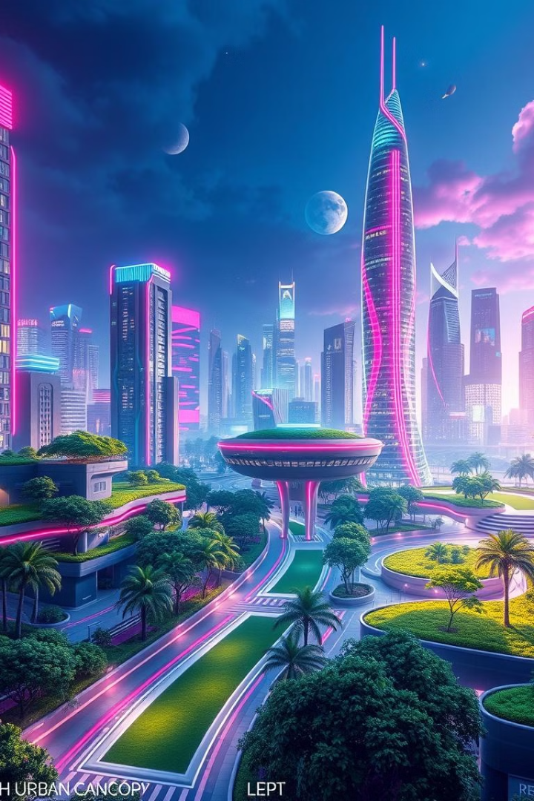
Join Us in Shaping a Sustainable Future
Tech Urban Canopy is seeking seed funding of €500,000 to scale our operations, product development, and market reach. We invite you to join us in this exciting journey to transform urban environments.

